Slide 1

Primary Years Programme
© International Baccalaureate Organization 2015
International Baccalaureate® | Baccalauréat International® | Bachillerato Internacional®

Slide 2

What you need to know about the IB and the Primary Years Programme
© International Baccalaureate Organization 2015
International Baccalaureate® | Baccalauréat International® | Bachillerato Internacional®

Slide 3
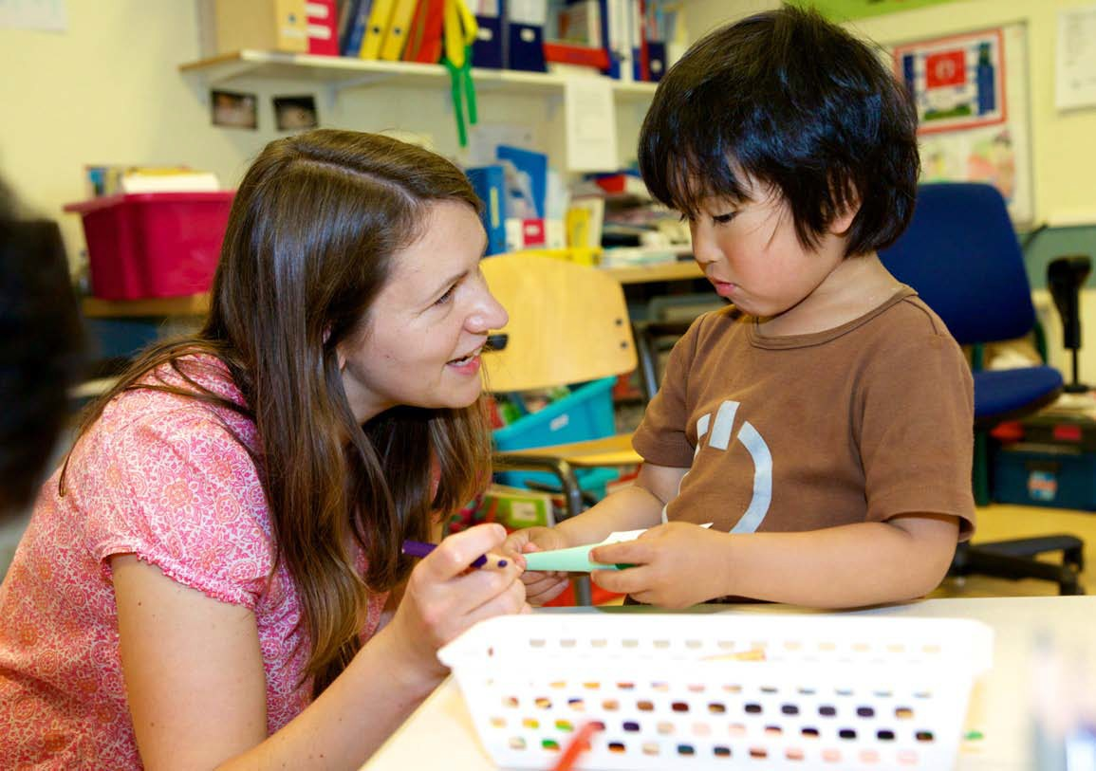

So what exactly is the International Baccalaureate?
“... The International Baccalaureate (IB) is a non-profit foundation, motivated by its mission to create a better world through education”

Slide 4


...The International Baccalaureate aims to develop inquiring, knowledgeable and caring young people who help to create a better and more peaceful world through intercultural understanding and respect...

Slide 5
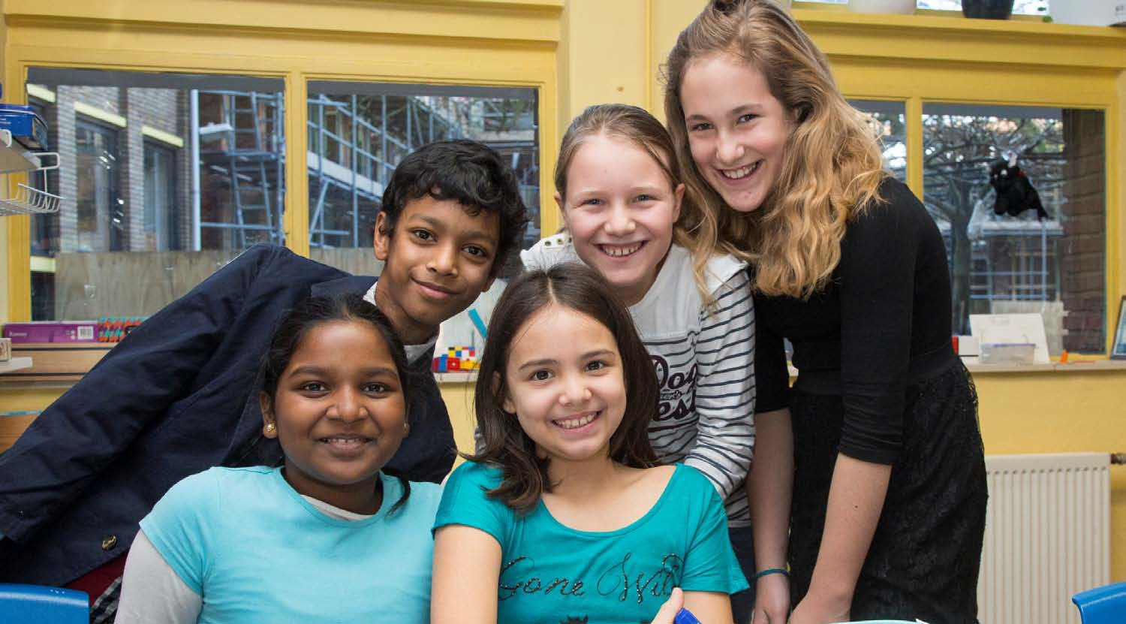

...Our programmes encourage students across the world to become
active, compassionate and lifelong learners who understand that other people, with their differences, can also be right....

Slide 6

IB learner profile
The IB learner profile is the IB mission statement translated into a set of learning outcomes for the 21st century
As IB learners we strive to be:
  inquirers
  knowledgeable
  thinkers
  communicators
  principled
  open-minded
  caring
  risk-takers
  balanced
  reflective

Slide 7
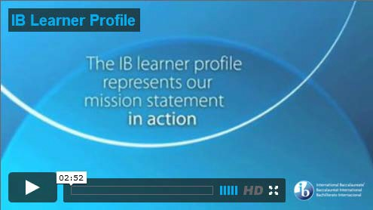
The IB Learner Profile

Slide 8
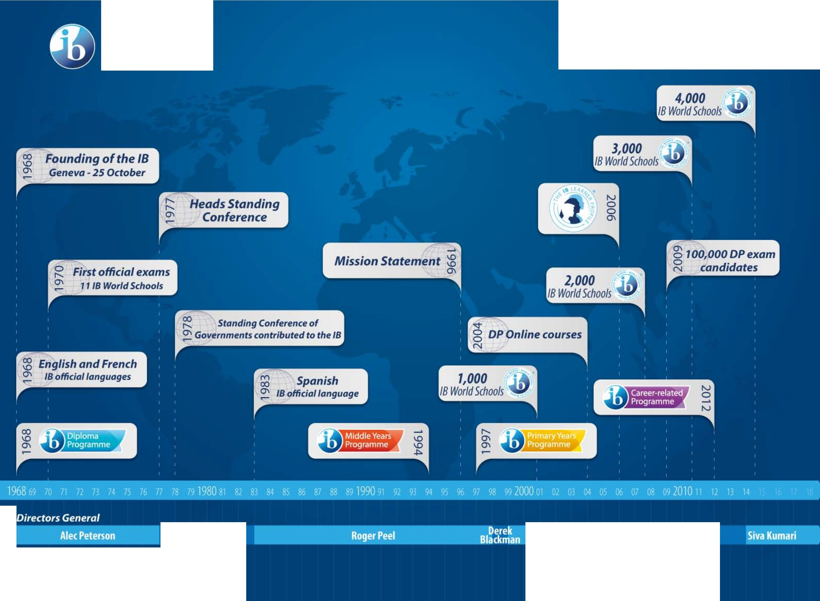
International Bacc alaureate Baccalaureat Inte rnat io nal Bachillerato Inte rnaciona l
"
/8 History timeline
Gerard Renaud
George Walker
Jeffrey Beard

Slide 9

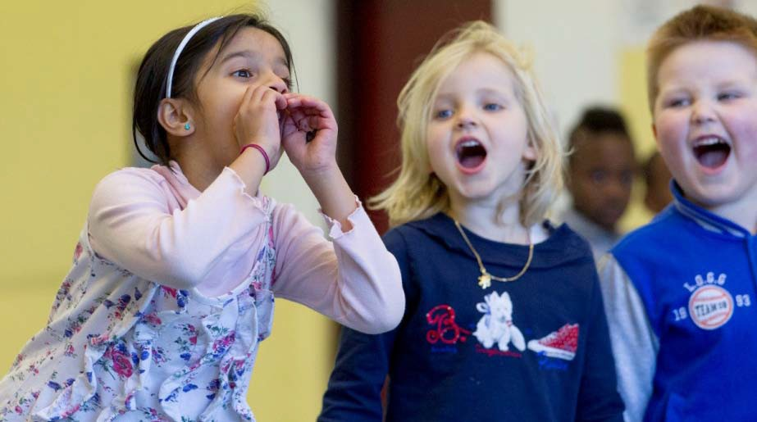
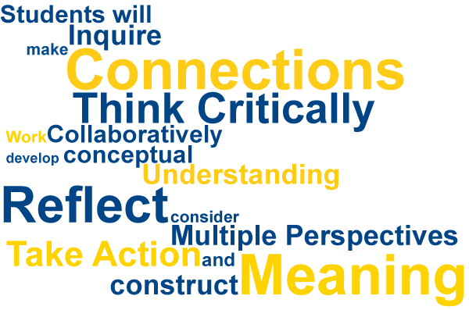
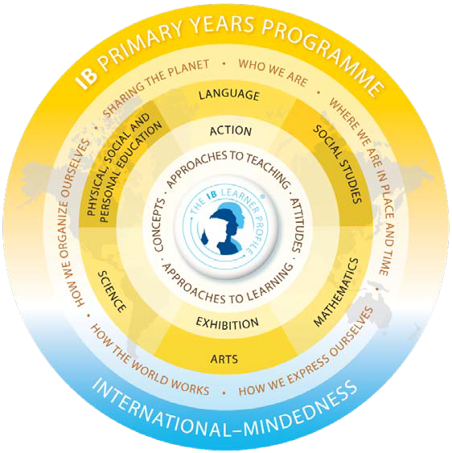

Slide 10
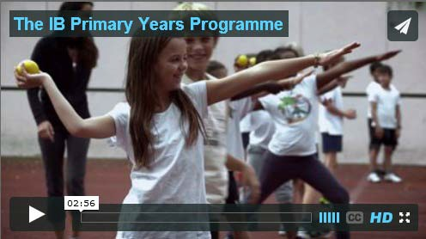
Primary Years Programme

Slide 11
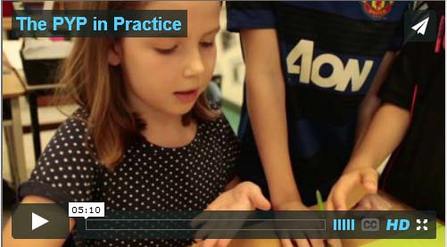
The PYP in Practice
6/1/2015 10

Slide 12




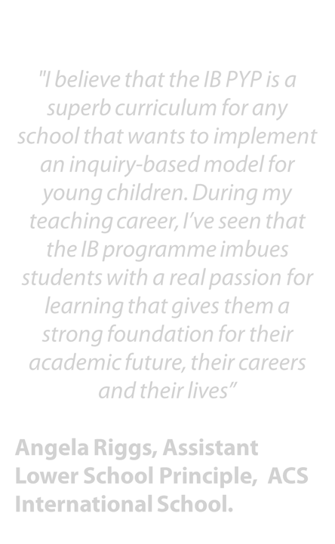
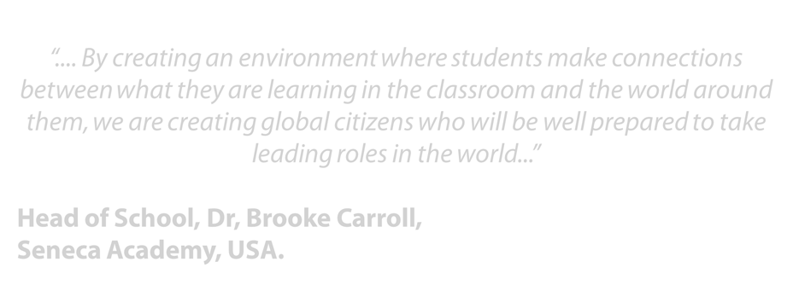


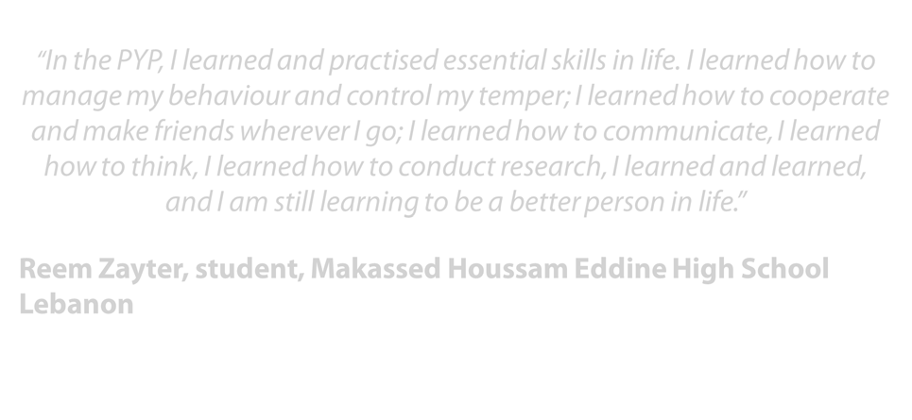
What are people saying about the PYP?
“.... By creatingan environmentwherestudents make connections betweenwhat they are learning in the classroom and the world around them, we are creating global citizens who will be well preparedto take leading roles in the world...”
"I believe that the IB PYP is a superb curriculum for any school that wants to implement an inquiry-based model for youngchildren. During my teachingcareer, I’ve seen that the IB programmeimbues studentswith a real passion for learningthat gives thema strong foundation for their academicfuture, their careers andtheir lives”
Head of School, Dr, Brooke Carroll, Seneca Academy, USA.
“In the PYP, I learned and practised essential skills in life. I learned how to managemy behaviour and control my temper; I learnedhow to cooperate andmake friends wherever I go; I learnedhow to communicate, I learned howto think, I learnedhow to conduct research, I learnedand learned, and I am still learning to be a betterperson in life.”
Reem Zayter, student, Makassed Houssam Eddine High School Lebanon
Angela Riggs, Assistant Lower School Principle, ACS International School.

Slide 13
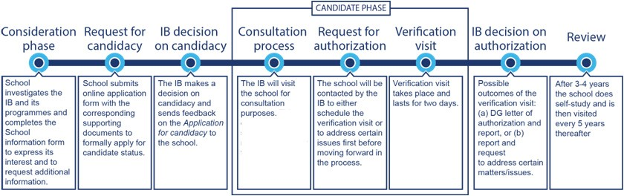

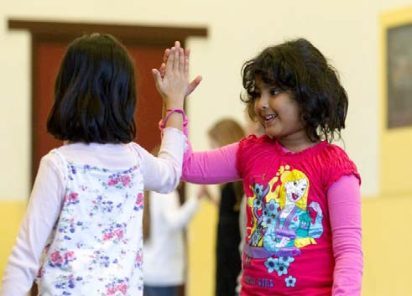
How is a school authorized and reviewed?

Slide 14
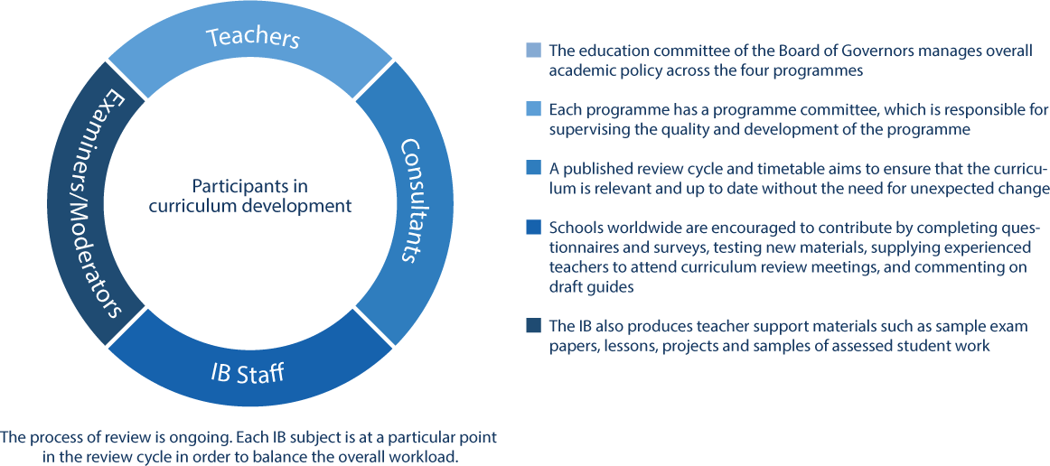
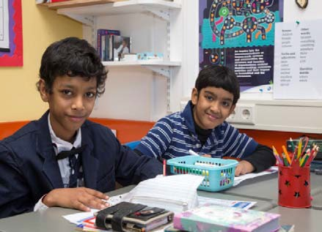
How the IB develops its curriculum:

